Slide 1
Primary Aldosteronism
Dr Mitra Mehrad
Nephrologist

Slide 2
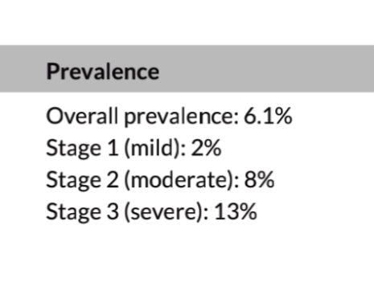
Introduction
Arterial hypertension (AH) represents one of the main risk factors for premature death, affecting about 10 to 40% of the world population
For the last seven decades, primary aldosteronism (PA) has been gradually recognized as a leading cause of secondary hypertension harboring increased risks of cardiovascular incidents compared to essential hypertension
Primary aldosteronism (PA) is the most frequent cause of endocrine AH, with a prevalence of around 4% and 10% in hypertensive patients treated in primary and tertiary care services, respectively, reaching around 20% of patients with resistant AH

Slide 3
Introduction …continued
The chronicle of primary aldosteronism (PA) commenced in the 1950s when aldosterone was discovered by Simpson and Tait .
Conn first clarified the details of PA in a young woman in 1955.
Physiologically, aldosterone is a key hormone in the regulation of blood pressure and electrolyte homeostasis
Inappropriately high aldosterone levels with respect to their physiological regulators, as occurs in primary aldosteronism (PA),
an important role in the development of arterial hypertension
and drug resistant hypertension (RH)
and are associated with increased cardiovascular, metabolic, and renal complications

Slide 4
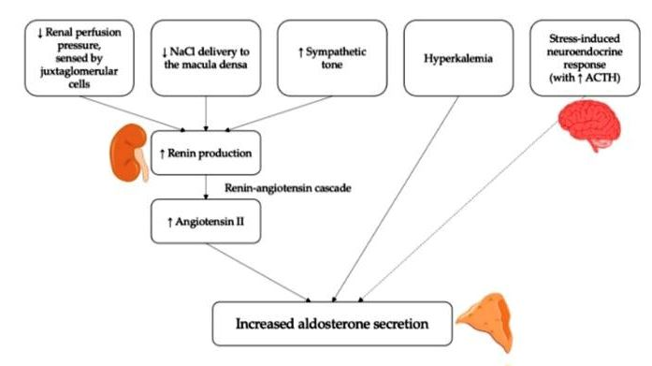
Physiological Role of Aldosterone in the Regulation of Blood Pressure

Slide 5
Pathological Consequences of Aldosterone Excess
not only
its well-known effects on water and sodium reabsorption in the kidney,
but also
its pro-fibrotic, proinflammatory, and pro-oxidative action in several target tissues…….(non-classical effects)
The clinical relevance of PA, however, goes far beyond its prevalence; in fact, aldosterone excess determines an increased risk of cardiovascular events and target organ damage , independent from the degree of blood pressure elevation.
Patients with PA suffer from an increased risk of atrial fibrillation, heart failure, coronary artery disease, stroke, and cardiovascular mortality, compared to matched essential hypertensives with similar blood pressure levels.

Slide 6
The most important mechanisms that lead to an abnormal increase in blood pressure levels in patients with PA are those exerted on the kidney. At a renal level, in fact, aldosterone excess determines an inappropriately high distal tubular resorption of sodium, which prevails on the actual sodium/volume status and leads to extracellular volume expansion
RH is defined as uncontrolled blood pressure despite appropriate lifestyle measures and treatment with ≥3 anti-hypertensive agents of different classes at maximal or maximally tolerated doses, including a diuretic and, typically, a calcium-channel blocker (CCB) and a blocker of the renin-angiotensin system (i.e., an angiotensin-converting enzyme inhibitor [ACE-i] or an angiotensin receptor blocker [ARB])
PA and RH frequently coexist.

Slide 7
It is now well established that add-on treatment with a MRA in patients with RH, even in the absence of a clear diagnosis of PA, is effective in lowering blood pressure, as highlighted in the PATHWAY-2 study, the first randomized controlled trial comparing different antihypertensive treatments in patients with RH
Moreover, the response to MRA treatment had a clear inverse relation with plasma renin, being spironolactone especially effective at lower plasma renin levels,
Potential role for aldosterone excess and MR activation in the development of RH even in the absence of a defined diagnosis of PA

Slide 8
Pathophysiological Role of Aldosterone Excess in the Development of a RH Phenotype
Salt Retention and Volume Expansion
At a renal level, in fact, aldosterone excess determines an inappropriately high distal tubular resorption of sodium, which prevails on the actual sodium/volume status and leads to extracellular volume expansion ,
current guidelines recommend MRA as the preferred drug class that should be added as a fourth medication in RH patients

Slide 9
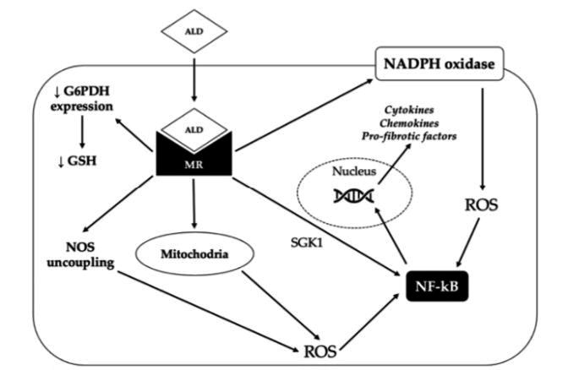
Oxidative Stress, Inflammation, Endothelial Dysfunction, and Fibrosis
The deleterious effects of aldosterone excess at a vascular level (i.e., oxidative stress, inflammation, endothelial dysfunction, fibrosis, vascular remodeling, and increased arterial stiffness) and at a renal level (i.e., hypertrophy/hyperplasia of distal tubule cells, oxidative stress, vascular and tubular inflammation and fibrosis) likely determine and promote a vicious

Slide 10
Sympathetic Nervous System Overactivity
At a neural level, there is evidence that aldosterone can increase sympathetic nervous system (SNS) activity and impair baroreflex response
Expression of MR has been demonstrated in the paraventricular nucleus (PVN), a hypothalamic nucleus involved in the regulation of sympathetic drive; MR-blockade has been shown to decrease NADPH oxidase activity and superoxide generation in the PVN of rats with heart failure, with a concomitant reduction of chronic excitation of neurons in the PVN and plasma NE levels

Slide 11
Adipose Tissue Dysfunction, Insulin Resistance, and Obesity
From a molecular point of view,
this might be a consequence of the action exerted by aldosterone on adipose tissue function: aldosterone has been shown to reduce the release of insulin-sensitizing mediators by the adipocytes and pre-adipocytes by inducing pro-inflammatory effects in the adipose tissue and altering adipokine expression , thus promoting insulin-resistance both in animal models and in humans.
Aldosterone has also shown inhibitory effects on insulin signaling and insulin-stimulated glucose uptake via glut-4 in adipocytes, skeletal muscle, and vascular smooth muscle cells
The link between aldosterone excess and OSA is bilateral

Slide 12
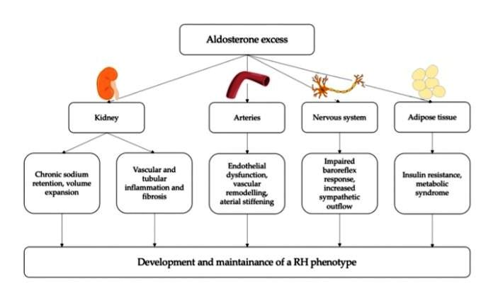

Slide 13
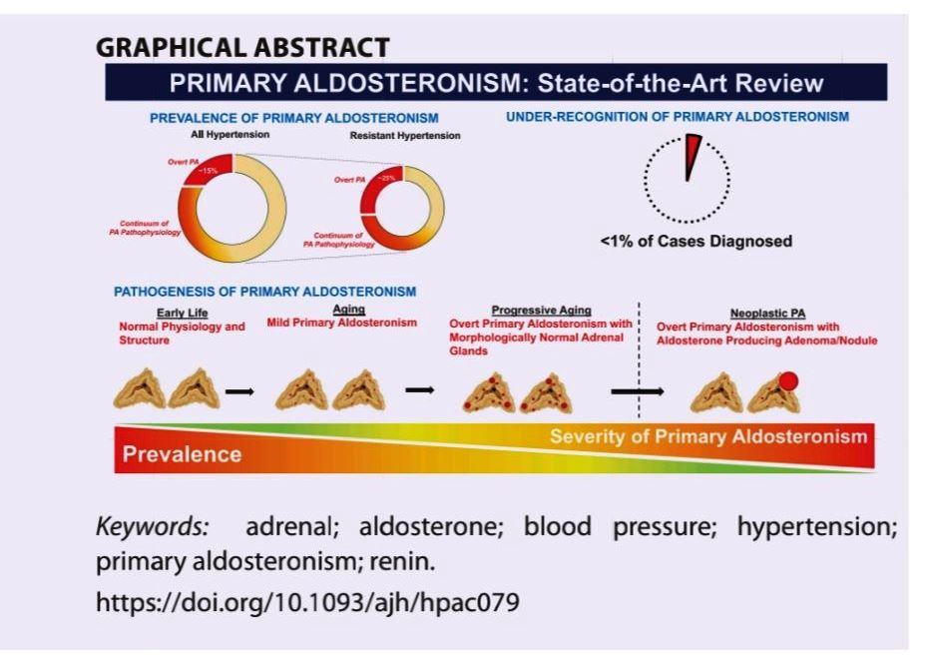

Slide 14
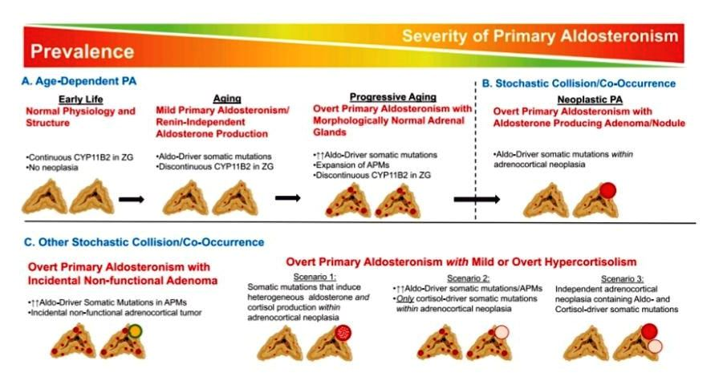

Slide 15
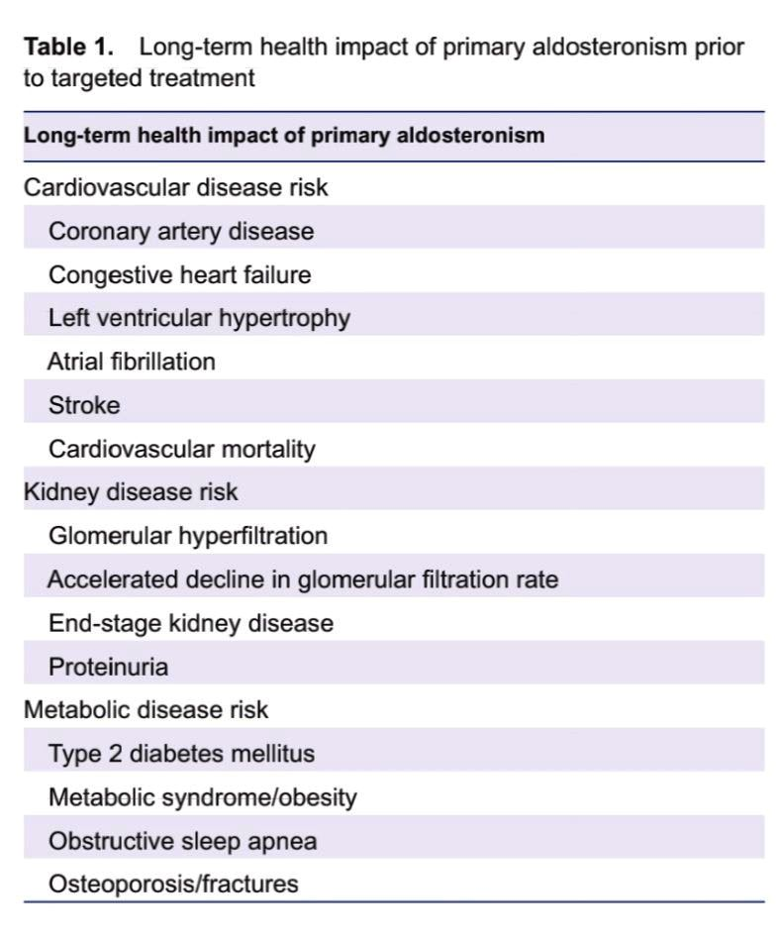

Slide 16
Clinical Subtypes of PA
In symptomatic PA, more than 90% of all PA are nonhereditary cases. Those acquired PA consists of two clinical subtypes, unilateral and bilateral forms that the Endocrine Society recommends differentiating by AVS .
Unilateral PA is known as a surgically curable case, mostly caused by APAs , and bilateral PA, so-called bilateral hyperaldosteronism (BHA) is roughly considered as nontumorous entity which requires mineralocorticoid receptor blocking to abolish the increased cardiovascular risk
On the other hand, FH is an uncommon form which presents early onset of PA .
All subsets of FH are inherited by autosomal dominant pattern.
Genetic tests are recommended to detect FH in PA cases with a family history of hypertension and/or child-onset hypertension.
The genes responsible for FH types I, II, III, IV, and V
are CYP11B2/CYP11B1 chimeric gene, CLCN2, KCNJ5, CACNA1H, and CACNA1D, respectively

Slide 17
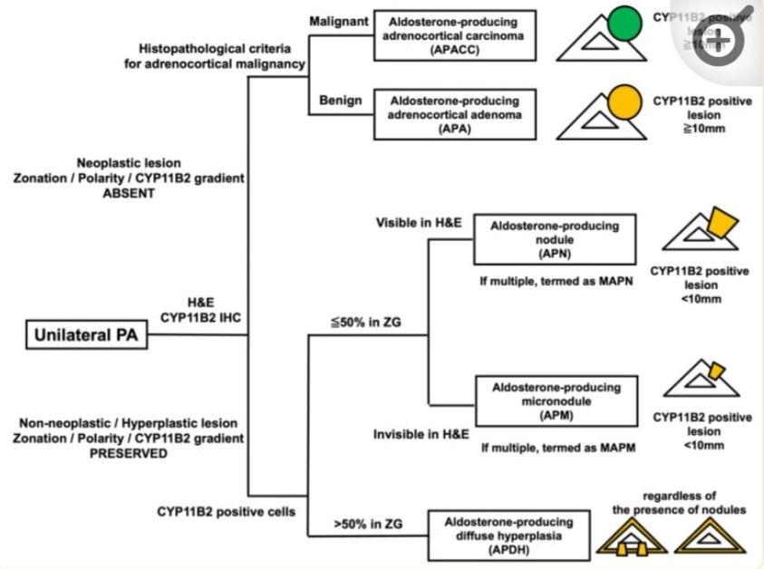
Histopathological Classification of PA and Their Expression Profiles of Steroidogenic Enzymes
The HISTALDO Consensus

Slide 18
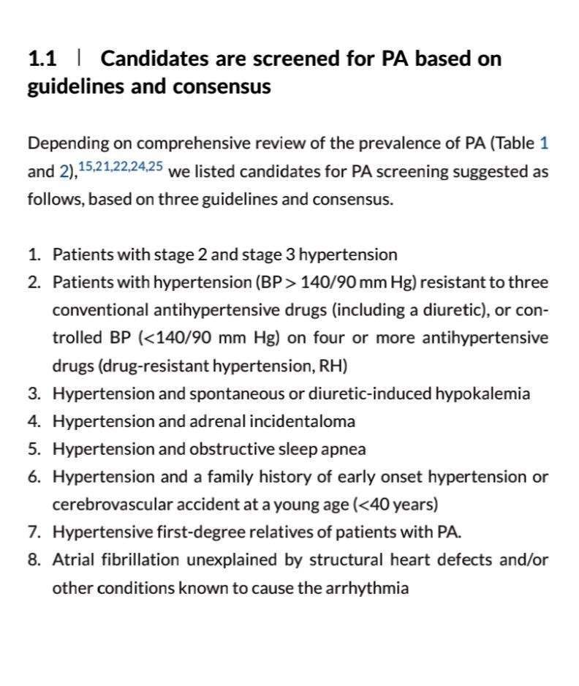
Who should be screened?

Slide 19
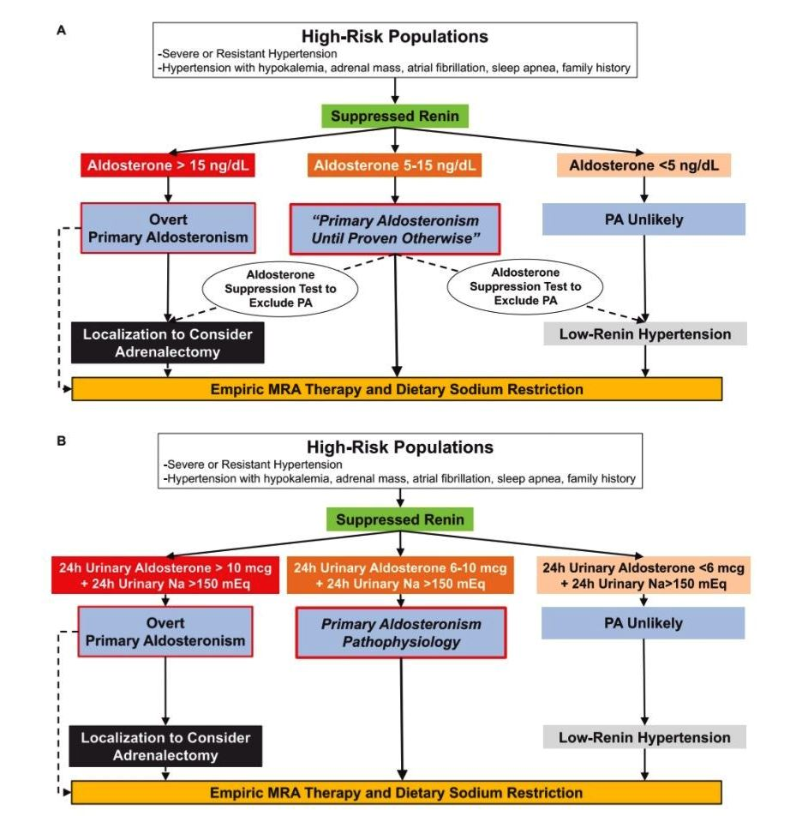

Slide 20
Diagnostic approach
In the current guidelines, PA confirmation is composed of two steps, screening and confirmatory tests
Based on the biochemical features of PA, including autonomous overproduction of aldosterone and subsequent renin suppression, screening for PA is performed with evaluation of both PAC and renin levels and its ratio
The reliability of the endocrinological evaluation is preserved when the testing conditions are set as under unrestricted salt diet and after correction of hypokalemia and adjustment of medications interfering the renin-angiotensin-aldosterone system (RAAS).
Subsequently, those candidates undergo one of any of the following confirmatory tests to prove the presence of PA: oral sodium loading test, saline infusion test (SIT), fludrocortisone-suppression test, and captopril challenge test

Slide 21
Proposed Bypasses in the PA Diagnostic Flow
Patients with a combination of a high PAC (>20 ng/dL), sufficient renin suppression and spontaneous hypokalemia at screening can directly proceed with the discriminative step by skipping the confirmatory step
In addition, subtype differentiation can be also circumvented in a case where a young patient has biochemically overt PA with a CT-detectable adrenal tumor. Existing evidence shows that younger age is associated with higher concordance between AVS and CT findings
In the patients younger than 35 years old with remarkable PA (spontaneous hypokalemia and obvious aldosterone excess) and a solitary adrenal tumor, adrenal imaging could identify unilateral PA with a very high specificity of 0.89–1.00

Slide 22
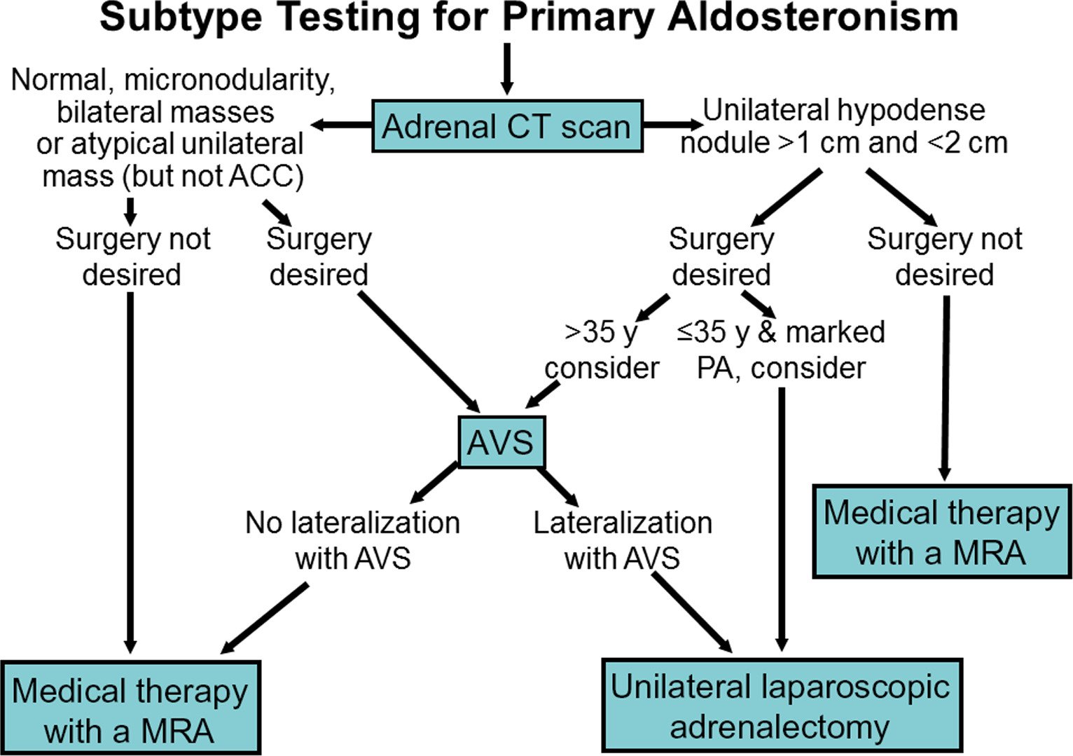

Slide 23

To my dear mother
……my dear Violet
THANKS

